Slide 1

Employee Data Analysis Using Excel
Presented By - SAI MEERA.K Register No. -A1311B75CBD8B3A995E40A1E69A71E5F Department - Department of commerce Honours College - Sri Kanyaka Parameswari Arts & Science College For Women

Slide 2
Project Title
Employee engagement and satisfaction Using Excel

Slide 3
AGENDA
1.Problem Statement
2.Project Overview
3.End Users
4.Our Solution and Proposition
5.Dataset Description
6.Modelling Approach
7.Results and Discussion
8.Conclusion

Slide 4
Problem Statement
Overview
Employee engagement and satisfaction are crucial for organizational success, yet many companies struggle to measure and improve them.
Objective
To Identify key drivers of employee engagement and satisfaction
To Develop a data-driven approach to measure and improve engagement and satisfaction

Slide 5
Project Overview
Purpose
The purpose of this project is to develop a data-driven approach to measure and improve employee engagement and satisfaction, enabling organizations to increase productivity, retention, and overall success.
Scope
Analyze employee survey data to identify key drivers of engagement and satisfaction Create visualizations and dashboards to facilitate understanding and inform decision-making

Slide 6
End Users
HR professionals seeking to improve employee engagement and satisfaction
- Managers looking to enhance team performance and productivity
- Employees who want to provide feedback and see meaningful change

Slide 7
Solution and Value Proposition
Solution
Analyze employee survey data
Identify key drivers of engagement and satisfaction
Create visualizations and dashboards for informed decision-making
Develop recommendations for improvement
Value Proposition
Enhance employee experience and overall well-being
Improve productivity and retention

Slide 8
Dataset Description
Employee survey data (e.g., engagement, satisfaction, demographics) HR data (e.g., turnover rates, absenteeism, performance metrics)
Employee Demographics- Age, tenure, job role, department, location, etc. Survey Response Rates- Percentage of employees who responded to the survey, response rates by department or job role, etc.
Historical Trends -Previous survey results, year-over-year changes in engagement and satisfaction scores, etc.

Slide 9
Modelling Approach
Descriptive analytics: summarizing and visualizing data to understand trends and patterns Inferential analytics: identifying correlations and drivers of engagement and satisfaction Predictive analytics: forecasting future engagement and satisfaction levels

Slide 10
Results and Discussion
Key drivers of engagement and satisfaction (e.g., leadership, communication, recognition) Areas for improvement and recommendations Visualization of results (e.g., dashboards, charts, graphs)

Slide 11
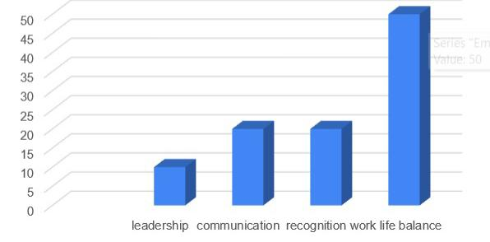
KEY DRIVERS OF EMPLOYEE ENGAGEMENT
EMPLOYEE ENGAGEMENT
DRIVERS OF ENGAGEMENT

Slide 12
Conclusion
Summary of Findings:
The data highlighted the importance of leadership, communication, and recognition in driving engagement
Strategic Recommendations:
Implement regular pulse surveys to monitor engagement and satisfaction
Foster a culture of open communication and recognition
Future Outlook:
Continuous monitoring and analysis of employee engagement and satisfaction will be crucial for driving meaningful change.
By prioritizing employee engagement and satisfaction, the organization can unlock its full potential and achieve long-term success.

